Slide 1
BOOSTING ALGORITHM
ADA BOOST
XG BOOST REGRESSION
LIGHT

Slide 2
What is an Ada Boost Regression?
Ada boot also known as Adaptive Boosting is a technique used in Machine Learning as an ensemble method.
The most common algorithm used with Ada Boost is decision Trees with one level, which means decision trees with one split.
* Ada Algorithm builds a model and gives equal weights to all the data points.
* It then assigns higher weights to points that are wrongly classified.
* Now all the points which have higher weights are given more importance in the next model.
* It will keep training models until and unless a lower error is received.

Slide 3
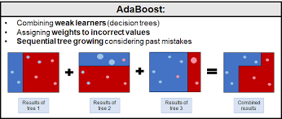

Slide 4
What is XG Boost Regressor?
XG BOOST was designed to be used with large, complicated data sets.
Supervised machine learning uses algorithms to train a model to find patterns in a dataset with labels and features and then uses the trained model to predict the labels on a new dataset’s features.
It provides parallel tree boosting and is the leading machine learning library for regression, classification, and ranking problems.
XGBoost builds upon: supervised machine learning, decision trees, ensemble learning, and gradient boosting.
GBoost is a scalable and highly accurate implementation of gradient boosting that pushes the limits of computing power for boosted tree algorithms.

Slide 5
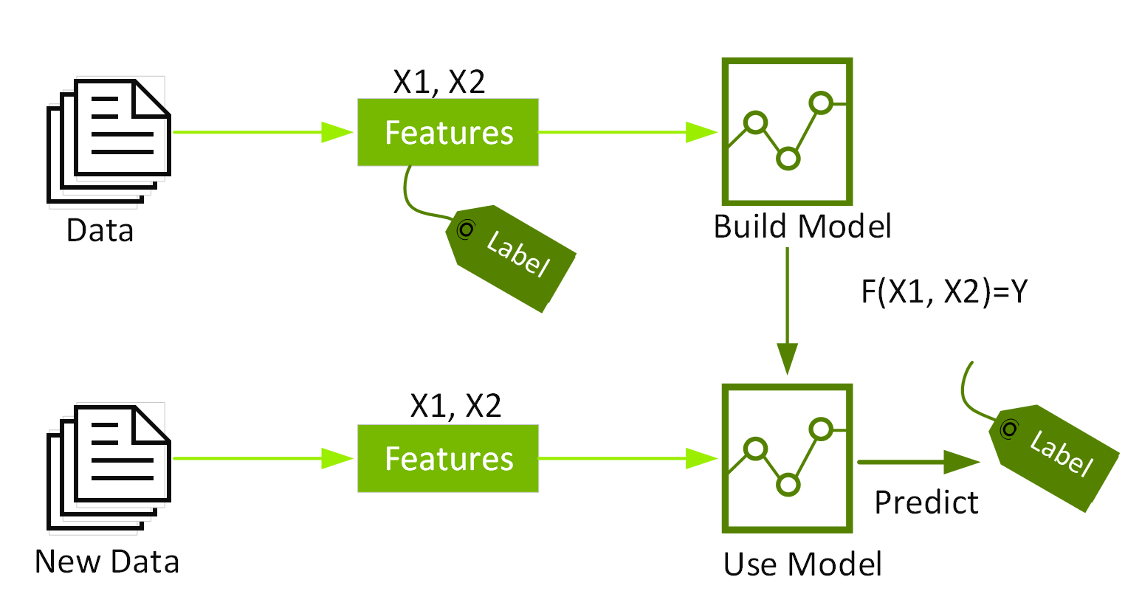

Slide 6
What is Light gbm Regressor?
LightGBM grows tree leaf-wise i.e. it grows vertically as compared to other algorithms which grow horizontally(level-wise growth).
The errors are minimized using the gradient-based method
Light GBM uses lesser memory and faster processing with large datasets.
It, is sensitive to smaller dataset, use it only when you have around 10,000+ rows.

Slide 7
